Slide 1
PTSD Timeseries Analysis
Zion Steiner

Slide 2
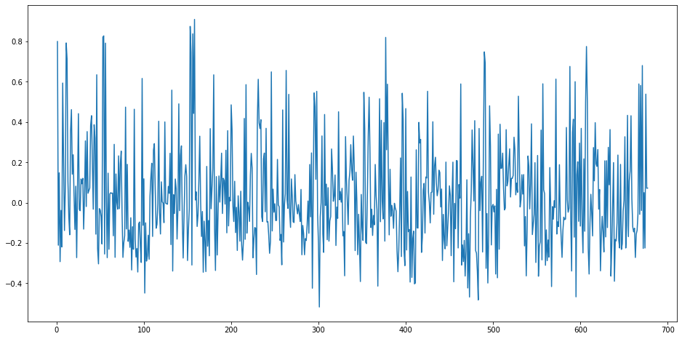
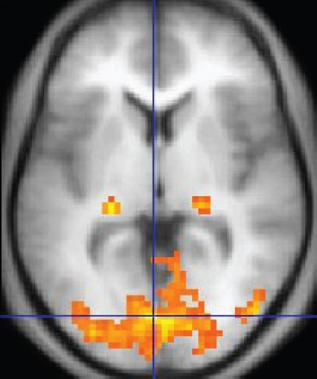
PTSD FMRI

Slide 3
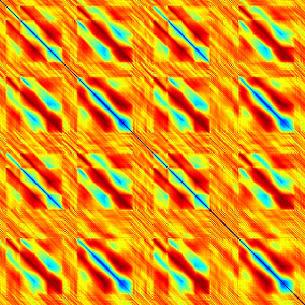
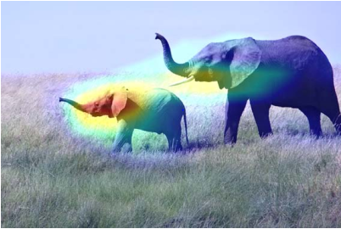
Goals
1
Classify the presence of PTSD in FMRI data using:
Motifs
CNN
Representation learning w/ SVM
Motif discovery via:
1. Matrix profile
2. CNN Activation Heatmapping
2
Matrix Profile I: All Pairs Similarity Joins for Time Series: A Unifying View that Includes Motifs, Discords and Shapelets. Chin-Chia Michael Yeh, Yan Zhu, Liudmila Ulanova, Nurjahan Begum, Yifei Ding, Hoang Anh Dau, Diego Furtado Silva, Abdullah Mueen, Eamonn Keogh (2016). IEEE ICDM 2016
Franceschi, J., Dieuleveut, A., & Jaggi, M. (2020, January 03). Unsupervised Scalable Representation Learning for Multivariate Time Series. Retrieved October 21, 2020, from https://arxiv.org/abs/1901.10738

Slide 4
